Slide 1

Midterm Presentation
Project Conceptualization
Project Title: Developing a Tool for Collaborative Cinematic VR Production
Group: Filipe & Isaac
Practical assignment goal: Development of a VR application using a human-centered approach, specific devices and libraries.
RVA

Slide 2
Introduction
A Tool for Collaborative CVR Production
Cinematic Virtual Reality is just starting and is already very appealing to many film enthusiasts for its capacity of immersion.
Production tools still rely on traditional 2D methods, but VR itself can be a means to produce the final result. This project attempts to prove such concept.
The reason we chose this project was its nature, the abstraction of the regular process of creating a final product to creating a tool that aids in the creation of products (in our case, videos).
We are not developing a film, a game or an experience, rather we are offering a tool for artists to be more equipped when creating such works.
Midterm Presentation - RVA 2020-2021
2

Slide 3
Project Vision
A Tool for Collaborative CVR Production
The project encompasses the implementation of the basic tools required for an artist (a user) to be able to create a virtual scene with animations and record a video, all while inside VR.
This work intends to be a proof of concept that VR experiences can be produced in VR, collaboratively.
Later work can involve comparisons of quality of workflow between traditional tools and immersed tools.
Midterm Presentation - RVA 2020-2021
3

Slide 4
Project Objectives
A Tool for Collaborative CVR Production
Concrete goals:
Support to wireless VR HMDs
Closed inventory of assets (objects, actors, etc.) for scene creation
Traditional controls over assets (translation, rotation, scaling)
Virtual virtual cameras control and video recording capacity
Simultaneous scene/asset control among connected users
Complexity reduction measures:
Online session management logic ignored (only local or hardcoded)
Creation (modeling/animation) of new assets unavailable
Recorded clips aren’t zipped together, regular video editing required later
Benefits of final product:
More humanly remote collaboration
“What you see is what you get”
Basis to studies determining which are the best methods of creating immersive cinematic experiences
Midterm Presentation - RVA 2020-2021
4

Slide 5
Personas
A Tool for Collaborative CVR Production
Carl Parker, 28 y.o., VR artist.
The film and commercials company Carl works at is opening a department for VR productions. He will be in charge of creating virtual scenarios and rendering 360 videos in them, along with other artists with no technological backgrounds.
Carl would benefit from a tool that would allow fast creation of video scenes without requiring advanced technical knowledge so that he can easily collaborate with is fellow coworkers.
Ellon Moore, 45 y.o., film production manager.
Mr. Ellon is in charge of the new department Carl will be working at. He wishes to make sure all productions are exactly as their clients expect them to be, so he must be able to look at the product from the user’s (immersed) perspective at all stages of project development and traditional VR development tools either provide only an on-screen perspective or involve time-consuming and sometimes expensive logistics.
Midterm Presentation - RVA 2020-2021
5

Slide 6
Personas
A Tool for Other VR Productions
Brax Rossi, 32 y.o., real estate agent.
Time management and business coordination can often become a hurdle for Brax. During the summer, Brax's portfolio often reaches up to 20 properties, and it costs time and money to travel across state.
Brax wants to show as many properties as possible, as his income relies on successful sales. He would like to show his client the potential of a particular property and the location around it without physically showing the house, so he would benefit from a tool that allowed him to build a virtual representation of the property and show it to his clients.
Annie Timms, 35 y.o., furniture and decoration store manager.
Annie owns a franchise furniture store that sells household furniture and decorations. After the outbreak of the pandemic, sales plundered by 50% and relied mainly on online purchases. The store manager has tried online marketing and other digital strategies. She is willing to take a different approach to excel in the digital market, so immersive experiences to present pieces placed in realistic scenarios to her customers could be an approach with potential.
Midterm Presentation - RVA 2020-2021
6

Slide 7
User Stories
A Tool for Collaborative CVR Production
As a VR artist, I want to introduce 3D models and animations into the scene to better illustrate what I am selling.
As a VR artist, I want to freely move around the scene and move objects to properly mimic a real world scene like a room or office.
As a VR artist, I want to work on my scene with others to increase production speed and improve overall quality.
As a VR expert, I want to be able to import new 3D models and animations usable in any scene.
As a Photographer/Camera Man, I want to create multiple cameras around the scene to better design which angle is most appealing.
As a Photographer/Camera Man, I want to open saved scenes and record videos for delivery.
As a Project Manager, I want to be able to quickly inspect the current state of a scene without waiting for rendered videos.
As a consumer, I want to see the produced video content so that I can choose the products that best fit me.
As a consumer, I want to see the produced video content so that I can entertain myself.
Midterm Presentation - RVA 2020-2021
7

Slide 8
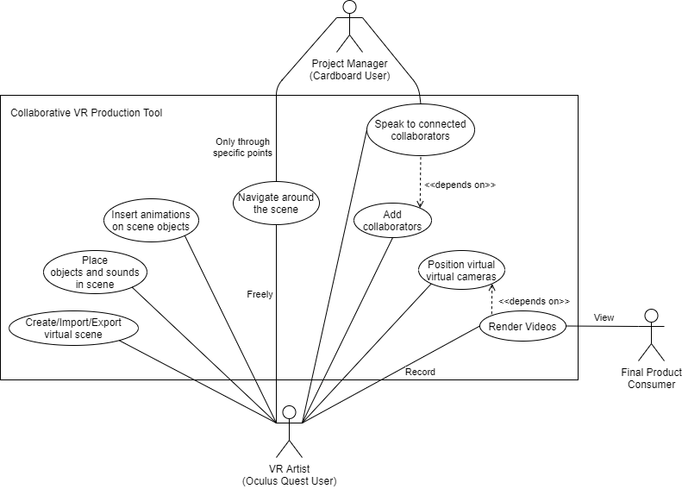
Visualization Aid
A Tool for Collaborative CVR Production
Midterm Presentation - RVA 2020-2021
8

Slide 9
Requirements
A Tool for Collaborative CVR Production
Quality requirements:
Run at 30+ fps
Be able to render videos at 30fps 720p or higher
Support 2+ users in same scene
Run in any Oculus Quest and Android 5.0+
Functional requirements:
Support standard 3D, animation and audio formats, insertable in scenes
Support object manipulation through controllers to personalize scene
Support camera manipulation through controllers to record videos in standard format
Support in-scene movement by teleportation through controllers (Oculus) or eye-gazing (Cardboard)
Provide local connection for real-time collaboration
Support scene management (save, load, etc.)
Midterm Presentation - RVA 2020-2021
9

Slide 10
Project Constrains
A Tool for Collaborative CVR Production
We added a self-imposed constraint consisting on resorting to UE4 rather than Unity for the implementation of the project
Mobility is crucial, so we intent to support only wireless HMDs (Oculus Quest 1 and 2, Google Cardboard)
This adds a processing capacity limitation, graphics will not be highly realistic
Collaboration requires fast internet connection
The biggest challenge will most likely be achieving a functional and intuitive method of camera manipulation as well as video recording in 360 degrees
Midterm Presentation - RVA 2020-2021
10

Slide 11
Next Steps
A Tool for Collaborative CVR Production
With the use cases created and prioritized, the requirements defined and the constraints set, we can begin to implement the prototype:
UE4 project with support for Oculus Quest
Virtual virtual camera for in-game video recording
Default inventory with empty scenes, static objects and animations insertable to objects
Command controls to choose tools
UI to manage scenes, inventory and video recording
Mechanism to save progress (JSON?)
We hope to also work on:
Adaptation of virtual camera for 360 videos
Local connection for multiple users
Management of control over assets by multiple users
Midterm Presentation - RVA 2020-2021
11

Slide 12
Midterm Presentation
The End
Any questions?
RVA

